Slide 1
Software design
Lab 1

Slide 2
Me – Andrei Corovei
A little over 7 years of experience in software:
4 years in the Telecom industry developing loyalty systems (2 years focused on database design and warehouses + 2 years on desktop applications + backend services) @Business Logic Systems
0.5 year experience working as a freelancer
2.5 years working in the learning field for the biggest learning company in the Nederland – NCOI. Mainly as a backend developer @Isdc / Endava
Currently - Software Developer @Qubiz
2nd year as a lab assistant @ SD

Slide 3

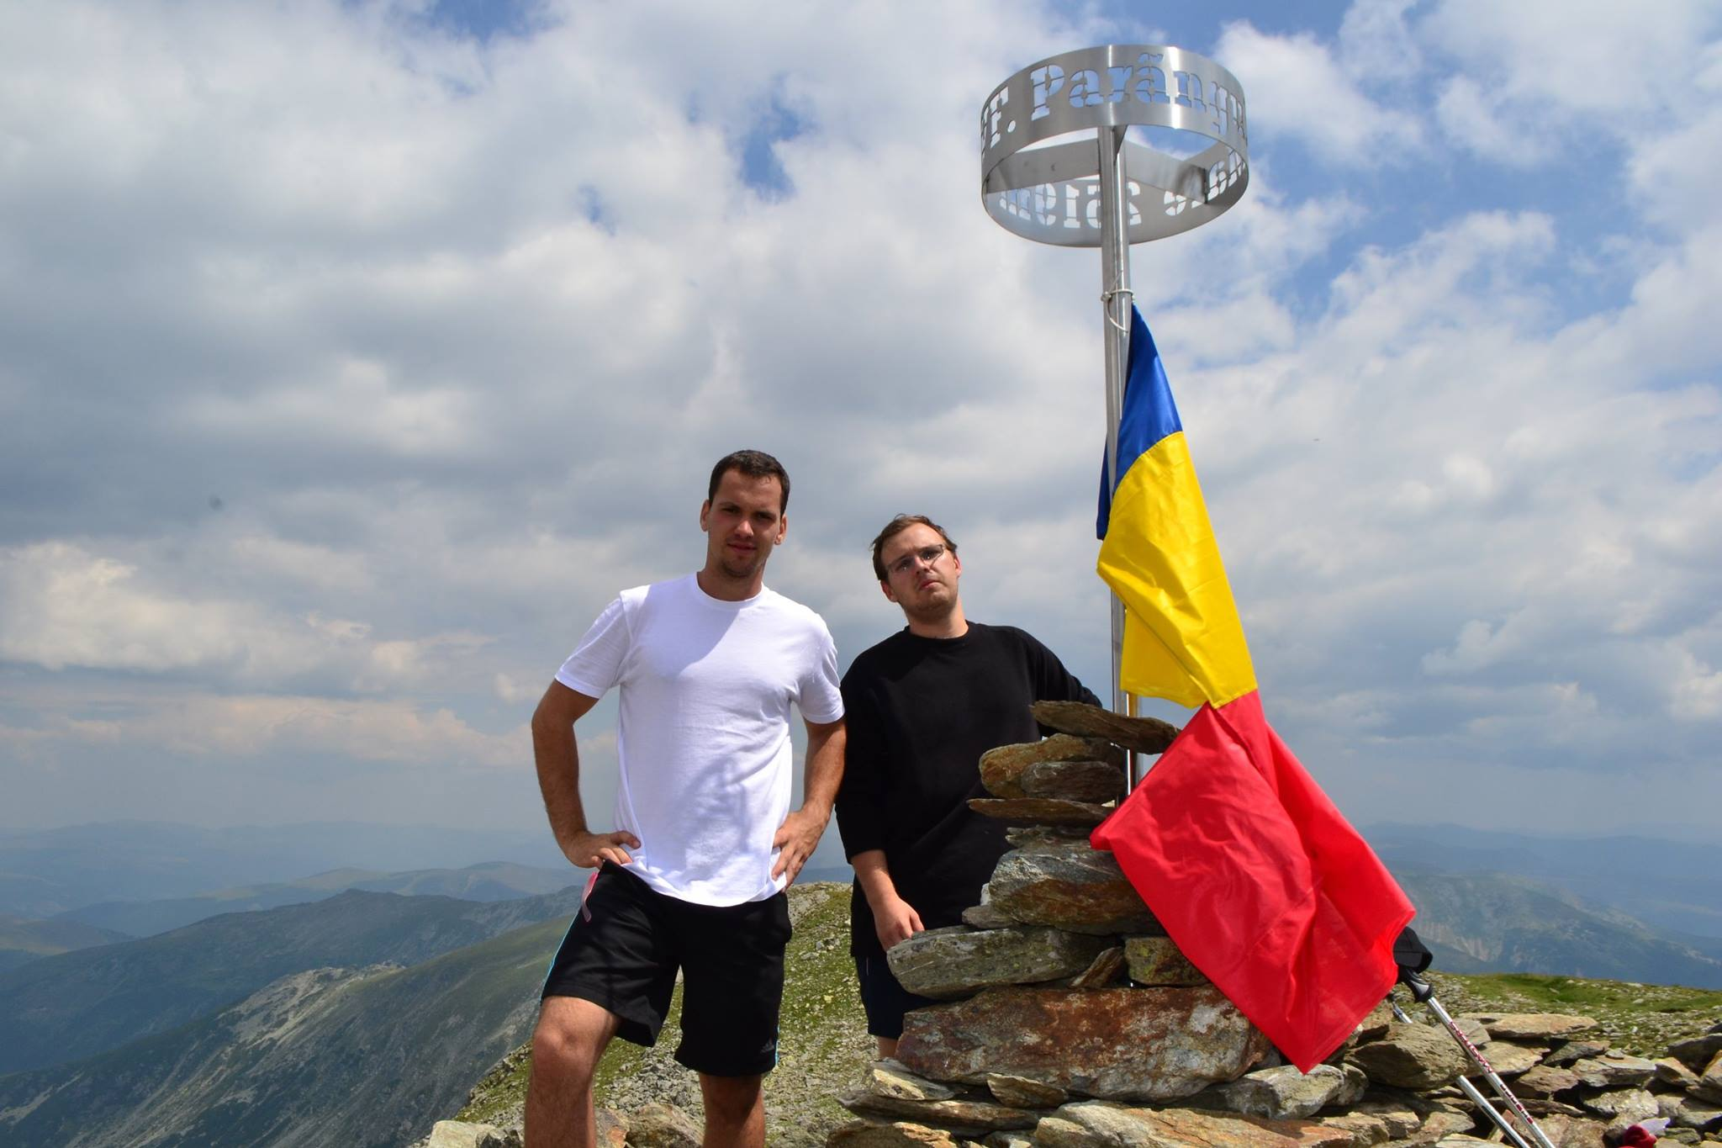

me +

Slide 4
Reading challenge 2016 - ongoing
2017 - 2018
Calea regilor – Brandon Sanderson
In cautarea oii fantastice – Haruki Murakami
27 de pasi – Tibi Useriu
Trilogia secolului (The century) – Ken Follet
Eu sunt Malala – Malala Yousafzai
Shantaram – Gregory Davind Roberts
A man called Ove – Fredrik Backman
Sapiens – Yuval Noah Harari
Cain and Abel – James Archer

Slide 5
me online
Very rarely blog at @ ideiandrei@blogspot.com
Facebook: Andrei.Corovei
Instagram: @Andrei.Corovei
Mail: Andrei.Corovei@gmail.com or a.n.d.r.e.i.c.orovei@gmail.com

Slide 7
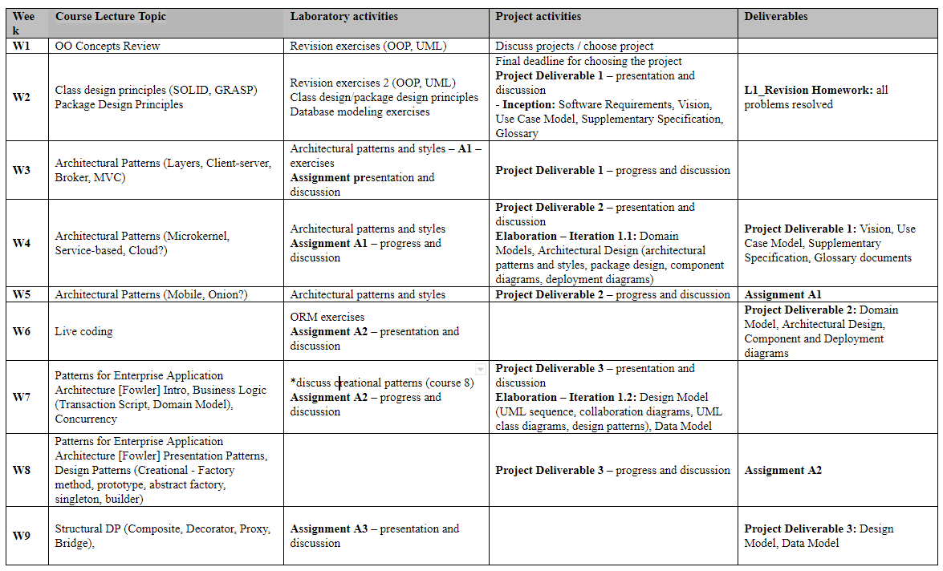
Schedule

Slide 8
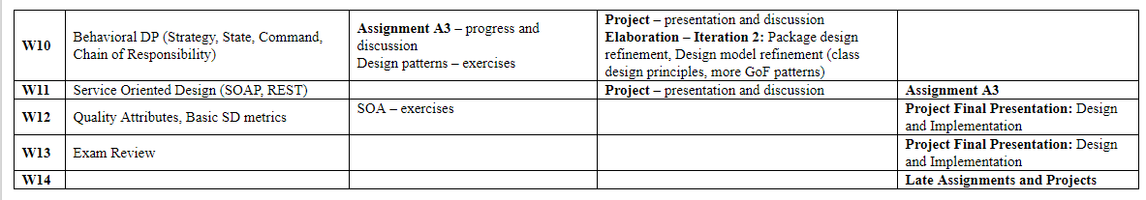

Slide 9
Rules and grading
You can miss 3 labs but you have to make a presentation about a given subject for the presence
Assignments and project deliverables must be presented when established. A delay of max 2 weeks is allowed with a penalty of 1 point/week.
A single assignment and project deliverable can be presented during a laboratory session. (I will start with the current assignment and just after that I will take the late assignments).
No migration between groups is allowed
Only one assignment and project deliverable can be submitted in the make-up session

Slide 10
Grading
Assignment grading = 0.4 * Documentation_grade + 0.6 * Implementation_grade
Project grading = 0.1*Deliverable1 + 0.1*Deliverable2 + 0.1*Deliverable3 + 0.3*Final Design + 0.4*Implementation
Extra points/ penalties can be given each lab

Slide 11
Some extra rules
I appreciate and understand personal effort and honesty – it might be the case that I will accept homework that is just 60-70% complete over one that is 100% complete but was copied. Therefore I encourage you to do the homework by yourselves.
I encourage you to discuss with me and within yourselves and ask when things are not clear. Take the time to ask as many questions as possible during the labs and send me emails whenever something is not clear. (I promise I will take the time to answer every email).
When submitting the homework I will also ask some basic theoretical questions and some questions about the project. The purpose of these questions is to make sure that you understand the concepts and not learn them by hard. It is also a good time for you to ask for ideas for improvement.
Mistakes are totally allowed, allow yourself to do them. No one is perfect and the best way to get better is to recognize and learn from our mistakes. (“There are things that we know and things that we don’t know yet, and what we do next is all that matters”).

Slide 12
Some extra rules (cnt.)
Creating a repository and putting everything under source control is mandatory.
Don’t write fluff in the documentations. Focus on the diagrams and just a few lines to explain them should be enough.

